Slide 1
Boosting ALOGORITHM – REGRESSION
ADA BOOSTING
XG BOOSTING
LG BOOSTING

Slide 2
ADA-Boost
Weight Adjustment
Iterative Training
Ensemble Formation

Slide 3
ADA-Boost Principles
Weight Adjustment
Iterative Training
Ensemble Formation

Slide 4
ADA BOOST - Advantages
Enhanced Accuracy
Flexibility
Robustness & Handling of data issues
Interpretability
Adaptability

Slide 5
ADA BOOST - DisAdvantages
Sensitivity to Noisy data and Others
Potential for Overfitting
Computational Cost
Lack of Interpretability
Hyperparameter tuning
Sequential tuning & Parallelization

Slide 6
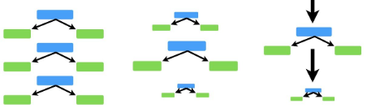
ADA BOOST - Picture

Slide 7
xg BOOST
Extreme Gradient Boosting
Fits to correct the prediction errors made by prior models
Splits the Trees at same depth

Slide 8
XG BOOST - Principles
Initial Prediction
Residual Calculation
Sequential Tree Building
Iteration and Error Correction
Loss Function Optimization
Regularization

Slide 9
Xg BOOST - Advantages
Execution Speed
Model Performance

Slide 10
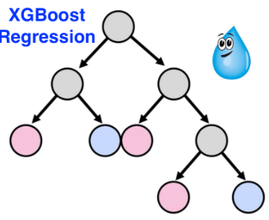
XG BOOST - picture

Slide 11
LG BOOSt
LIGHT GRADIENT BOOST – LIGHT GBM
Flexibility
Adds automatic feature selection
Handles Large Datasets
Sequentially adds Week Learners to improve model predictive power
Grows the branch with Max gain

Slide 12
lg BOOST - principles
Essemble Learning
Sequential Training
Gradient Descent
Residuals
LossFunction
Regularization

Slide 13
lg BOOST - Advantages
Enhanced Accuracy
Flexibility
Robustness & Handling of data issues
Interpretability
Adaptability

Slide 14
lg BOOST - disAdvantages
Potential Overfitting with High Learning rates
Computational intensity with Large datasets
Memory management challenges

Slide 15
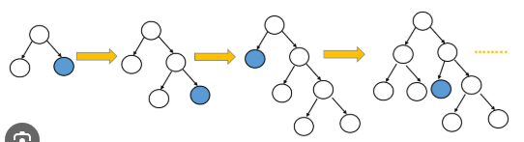
lg BOOST - picture

